Slide 1
The Analytics of Facebook
(as of 2019)

Slide 2
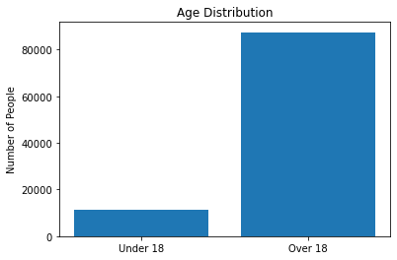
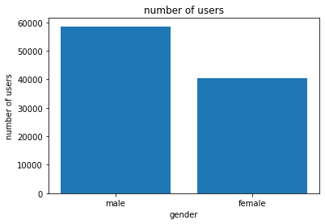
Our Data (Found on Kaggle)
There are 15 columns, 98k+ rows and more than 1.4 million data elements. According to our analysis, there are over 11k minors and over 87k are adults.
Number of rows: 98,826
Number of columns: 15
Number of data elements: 1,482,390
Based on the dataset there are 58k+ male users
& over 40k female users.

Slide 3
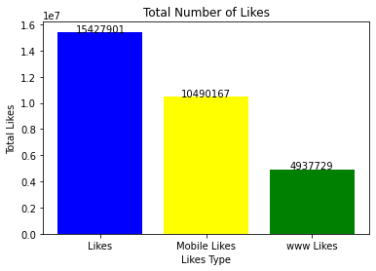
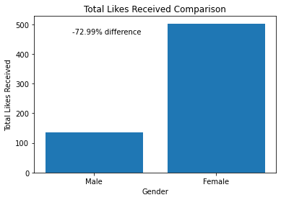
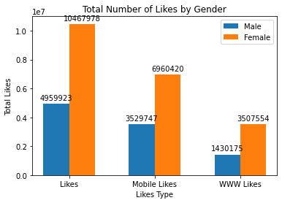
Differentiation and Analysis of Likes
Based on the dataset, it presents that the number of likes received by females is significantly more than the number of likes received by males.
This histogram represents the amount of likes in the data set which includes Total likes from mobile and likes of world wide web (website).
The comparison of likes received by Males and Females in percentage.

Slide 4
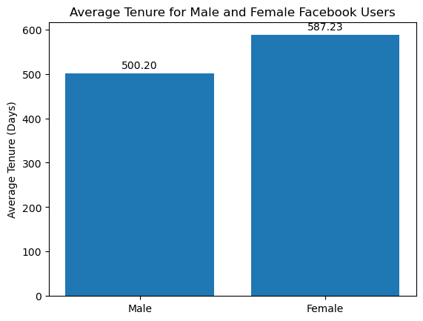
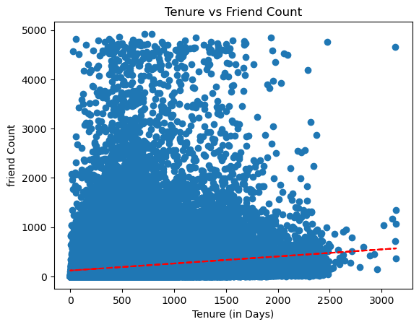
Gap between the two is minimal
Indicates that both male and female users are very enthusiastic about using Facebook
It is difficult to attribute usage differences to gender differences based on these results.
Low positive correlation between when a user created an account and how many friends they added.
Conclusion → Users meet more people as you they use FaceBook more, but it is not a drastic amount.
We can assume that people do not socialize more on FaceBook and prefer other options (Instagram, Snapchat)

Slide 5

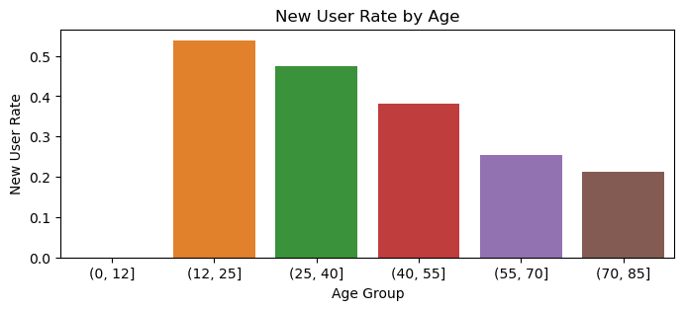
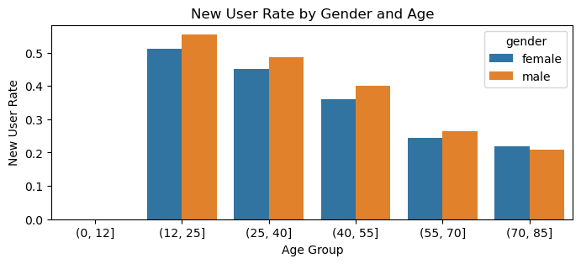
After creating the new user rate of < 365 days, we compared tenure with age and gender.
Results
Users who are in their teens and early twenties are are most likely to create an account.
Most active age group is 12-25.
Note: This data can have caveats since some users are new, while some users are churned.
Relating to gender, more males are new to the website.
Trends during 2019 can help us conclude that more people got access to the internet, which explains why more teenagers are logging on Facebook.
Note: The age group (0,12] is empty because the minimum age requirement to use FaceBook is 13.
Notes:
Churn data is a metric that represents the number of customers that have stopped using the product or service during a given period of time.
Talk about how investors should try to advertise to teenagers since our data shows that they are more likely to create an account and are the most active in regards to likes and tenure

Slide 6
Thank you for your attention!

